Slide 1
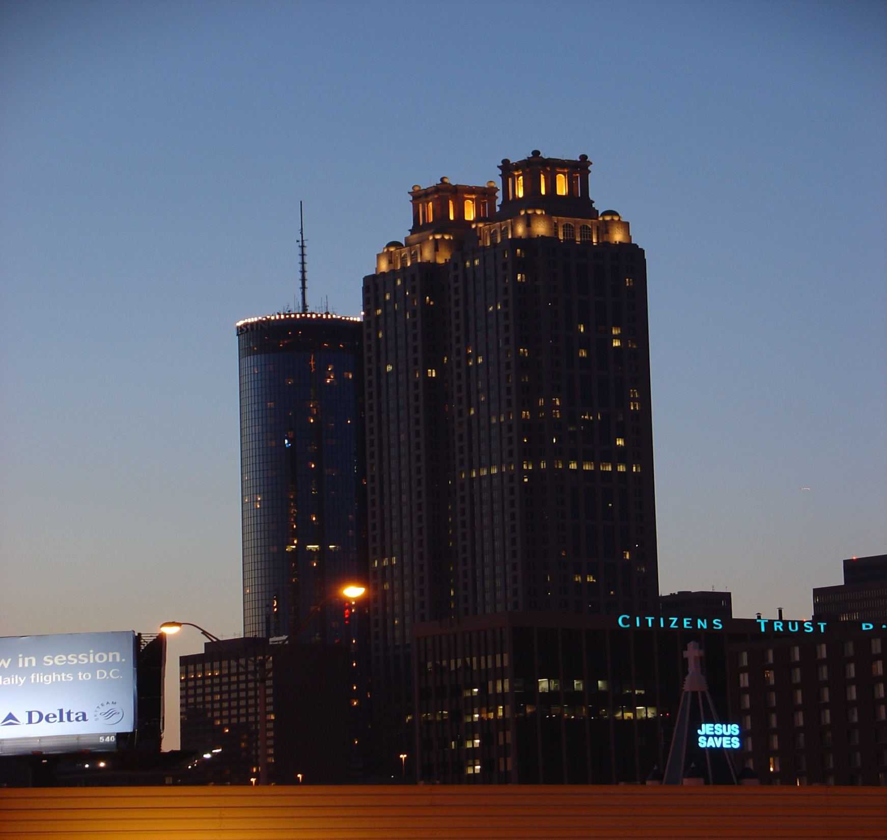
Atlanta Fire Rescue
Field Operations
Furlough Plan & Impacts
Notes:
1

Slide 2
City of Atlanta Code of Ordinances
The Fire & Rescue Department Shall:
Protect life and property:
  Against fire
  For Homeland Security & weapons of mass destruction.
  For life and property against danger at the Hartsfield-Jackson International Airport
  Continued →
Notes:
2

Slide 3
City of Atlanta Code of Ordinances
Provide First Responder services for:
  Hazardous chemical releases and spills.
  Persons trapped in vehicles, building collapse, trench, high-angle, water and tunnel rescue.
  Persons requiring emergency medical services.
Administration & enforcement of statutes, ordinances, & regulations related to fires & explosions.
Continued →
Notes:
3

Slide 4
City of Atlanta Code of Ordinances
Regulation of the installation & use of equipment that prevents fire hazards.
Initiate & conduct programs of public education in fire prevention & safety.
Detect and prevent arson.
Notes:
4

Slide 5
City of Atlanta Code of Ordinances
The reductions already in place and further impacts from furloughs challenge the Atlanta Fire Rescue Department’s ability to fulfill its obligations to the charge set forth by the City of Atlanta Charter.
Notes:
5

Slide 6
FY 2009 Budget Reductions
$13.1 million budget reduction
Three rounds of cuts
  $4 million: Resulted in elimination of 44 vacant firefighter positions, abolished 7 civilian positions, and transferred 12 civilian positions.
  $4.4 million: Resulted in combining two divisions of labor and 26 demotions from Deputy Chief to Fire Apparatus Operators. Elimination of 84 firefighter positions.
Notes:
6

Slide 7
FY 2009 Budget Reductions
Round 2 cuts continued:
  Eliminated Chief positions in Homeland Security, Public Education, Assessment & Planning.
  Eliminated video training programmer, 6 medical supervisors, Special Operations Battalion Chief positions.
  Reduced smoke alarm & child car seat program, reduced firefighter training staff.
  Eliminated firefighter health & wellness program.
Notes:
7

Slide 8
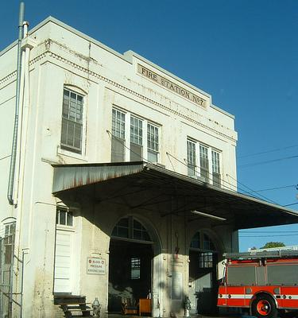
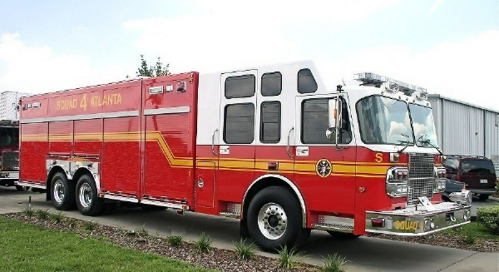
FY 2009 Budget Reductions
$4.7 Million in cuts
Closing of Station 7
Decommissioning of Squad 4
Reinstatement of Relief Days for Firefighters
Notes:
8

Slide 9
FY 2009 Staffing Impacts
Abolished 120 Firefighter positions
  Closing of Station (Engine) 7
  Decommissioning of Squad 4
  Decommissioning of Battalion 1 (Spec Ops)
  Demotions, layoffs
Reactivation of R-Days
Notes:
9

Slide 10
Field Operations Shift Strength
Field Operations Authorized Strength: 668
        Actual: 637
A-Shift Authorized: 223
        Actual: 209
B-Shift Authorized: 222
        Actual: 212
C-Shift Authorized: 223
        Actual: 216
Notes:
10

Slide 11
Minimum Staffing (per National Stds.)
Truck Companies: 4 X 13 = 52
Engine Companies: 4 X 29 = 116
Squad Engine: 6 X 1 = 6
Air Truck: 1 X 1 = 1
Command Teams: 2 X 6 = 12
Total Firefighters Required: 187
Notes:
11

Slide 12
Below Minimum Staffing Levels
(due to FY 2009 budget impacts)
Truck Companies: 3 X 13 = 39
Engine Companies: 3 X 24 = 72
Squad Engine: 6 X 1 = 6
Spec Ops Engines 4 X 5 = 20
Air Truck: 1 X 1 = 1
Command Teams: 2 X 6 = 12
Total Firefighters Required: 150
Notes:
12

Slide 13
Leave Usage
Annual Leave: 23 per day (maximum)
Sick Leave: 13 per day (average)
Misc Leave: 9 per day (average)
Relief Day: 24 per day (during R-day cycle)
Up to 45 firefighters off per day due to various leave times and special assignment (non R-Day cycle).
Notes:
13

Slide 14
Daily Staffing Impacts
With current staffing levels we cannot meet standard staffing requirements.
AFRD is challenged to meet our below minimum staffing level.
Notes:
14

Slide 15
FY 2009 2nd Quarter Reductions and Impacts
Hiring Freeze – No additional firefighters.
Furloughs of firefighters – An additional 24 firefighters off per day.
Notes:
15

Slide 16
Fiscal Impacts
Firefighter Relief Days
$2.1 Million
Firefighter Furlough Days
$1.9 million

Slide 17
Leave Usage
Annual Leave: 23 per day (maximum)
Sick Leave: 13 per day (average)
Misc Leave: 9 per day (average)
Relief Day: 24 per day (during R-day cycle)
Furlough Day: 24 per day
Up to 69 firefighters off per day due to various leave times, furlough and special assignment.
Notes:
17

Slide 18
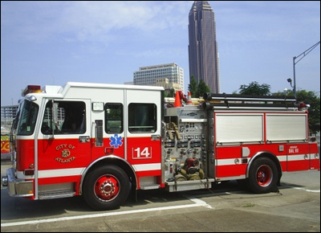
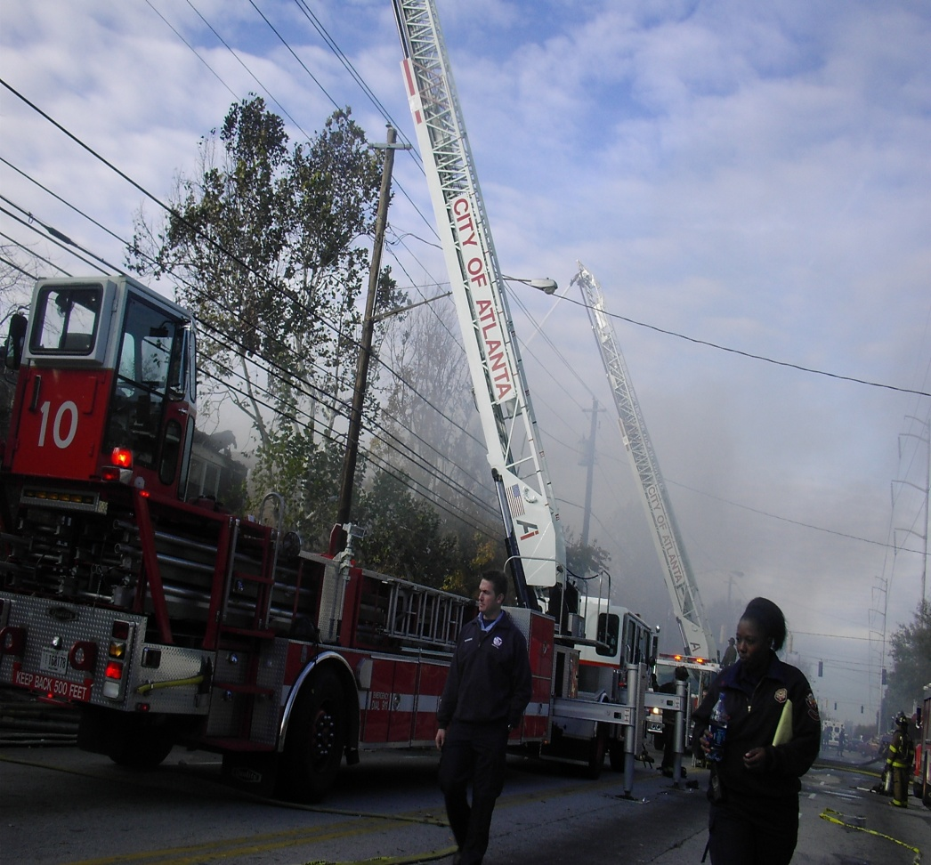
Understanding AFRD Terminology
Engine (Pumper) Company
Truck (Ladder) Company

Slide 19
What Types of Calls do our Apparatus Respond to?
Engine Company
Truck companies
Fires: All types of fires
Emergency medical calls
  Basic life support
  Advanced life support
Fire alarm investigations
Vehicle collisions
Gas leak
Hazardous materials spills
Victims trapped
Elderly assist calls
Electrical problems
Many other miscellaneous calls for service.
Structure fires
Victims trapped
  Vehicles
  Elevators
  Collapse
Water problems
Children locked in cars
Fallen trees
Hazardous materials spills
Elevated rescue
Parking deck fires
Many other miscellaneous calls for service .

Slide 20
AFRD Staffing Impacts
FY 2008 FY 2009 FY 2009
w/blackout
Engines 31 30 29
Trucks 13 13 12
Command 7 6 6
Teams
Squad 1 0 0
Air Unit 1 1 1
Notes:
20

Slide 21
Blackouts & Brownouts
Blackout – Closure of a fire engine or ladder truck for an extended period of time (for the remainder of FY2009) . This is due to staffing reductions.
Brownout – Temporary closure of a fire engine or ladder truck due to daily staffing fluctuations.
Notes:
21

Slide 22
Blackout & Brownout Selection Criteria
Call volume
Target risk hazards
Depth of coverage
Drive time analysis
Automatic aide agreements
Special functions i.e. Haz-Mat, technical rescue
Notes:
22

Slide 23
Engine Companies w/ Lowest Call Volume
E-27 (396) Automatic aide agreement
E-36 (660) Territory coverage
E-34 (670) Territory coverage
E-26 (991) Territory coverage
E-8 (992) Special Operations Company
E-25 (1167) Territory coverage
E-3 (1169) Target hazards
E-31 (1169) Territory coverage
E-28 (1248) Territory coverage
E-12 (1327) Territory coverage
Notes:
23

Slide 24
Truck Companies w/ Lowest Call Volume
T-31 (272) Territory coverage
T-26 (289) Territory coverage
T-12 (349) Blacked out
T-21 (352) Special Operations Company
T-29 (386) Target hazards
Notes:
24

Slide 25
Fire Companies Blacked Out
Truck 12
Engine 23
Notes:
25

Slide 26
Fire Companies With Potential to be Browned Out
Truck Companies
T- 25
T- 26
Engine Companies
E-12
E-22
E-26
E-30
E-36
Notes:
26

Slide 27
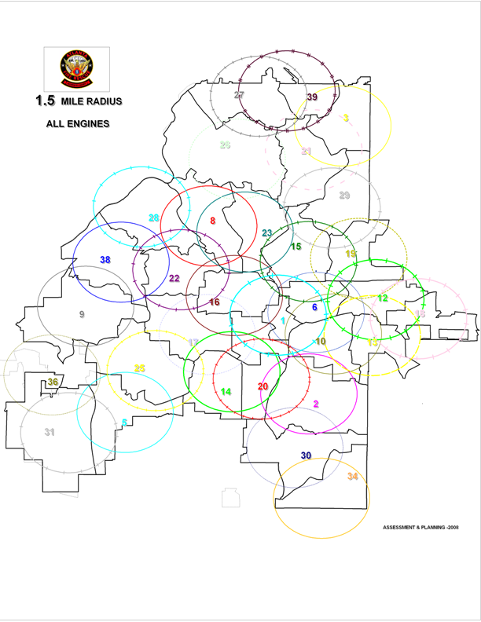

Slide 28
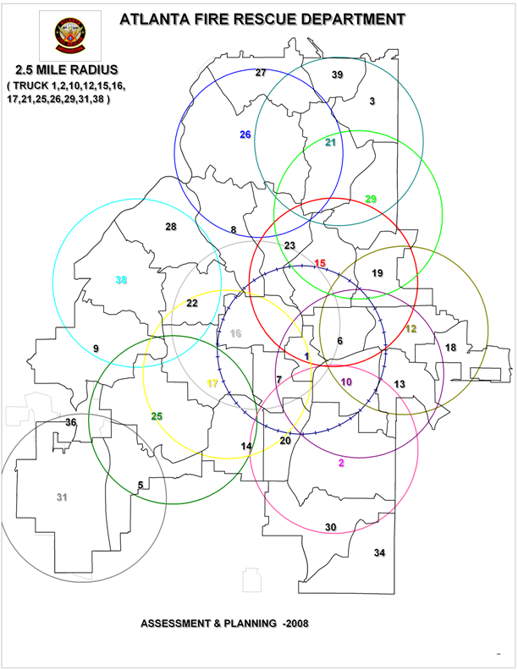

Slide 29
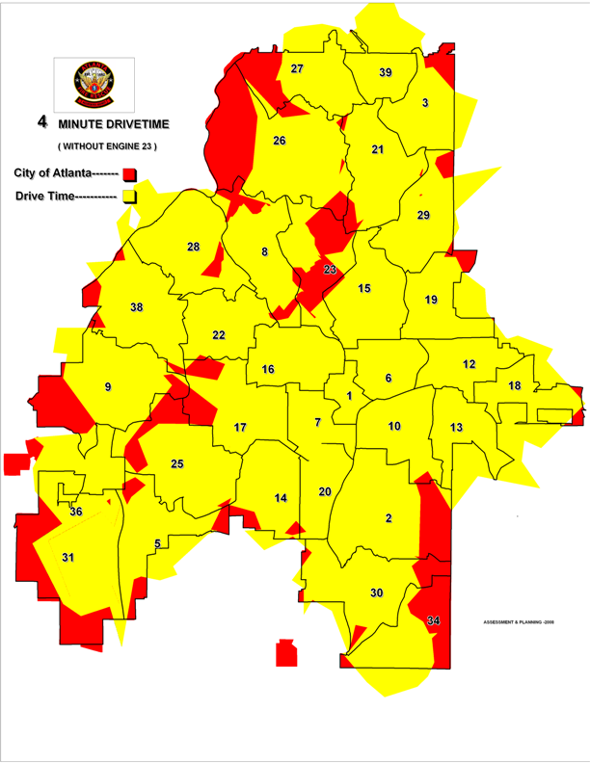

Slide 30
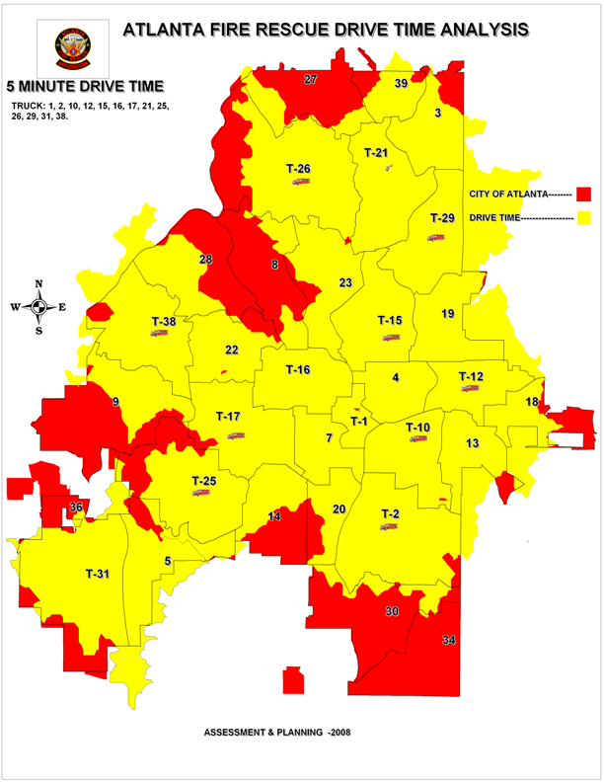

Slide 31
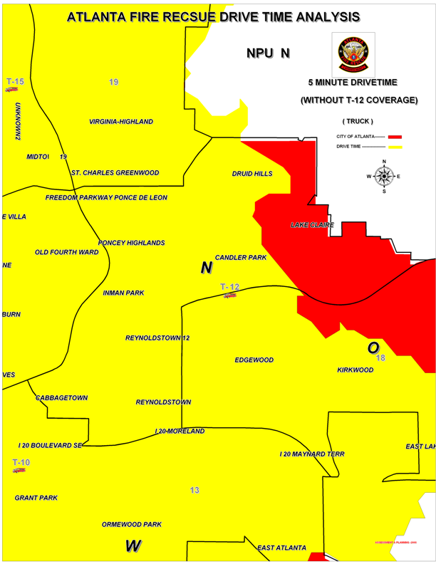

Slide 32
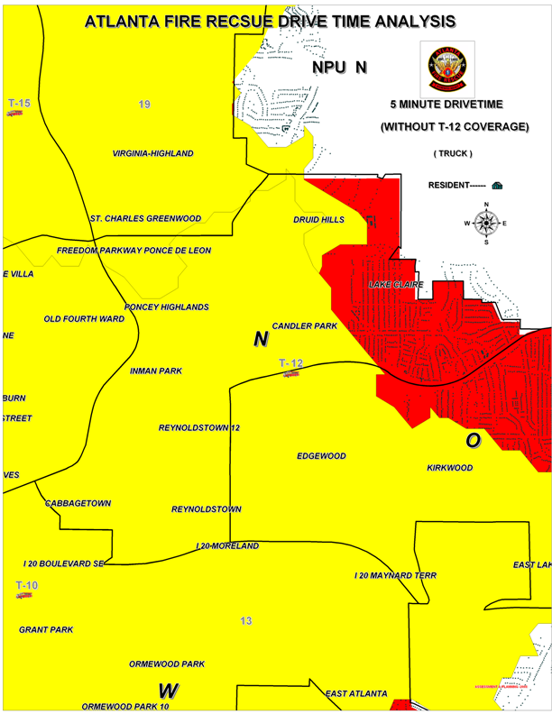

Slide 33
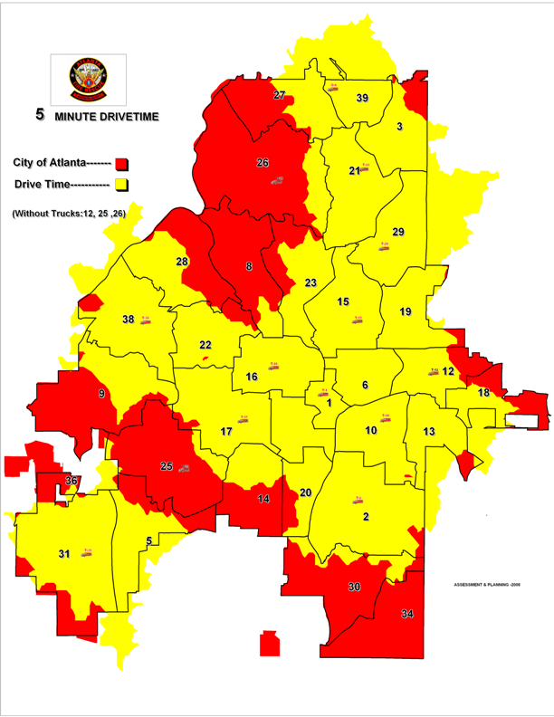

Slide 34
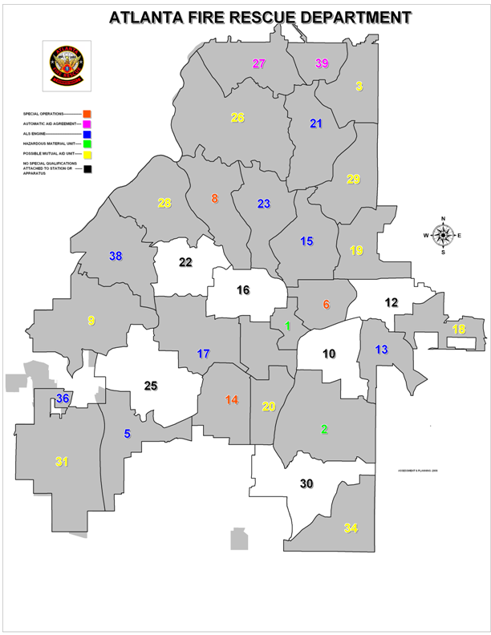

Slide 35
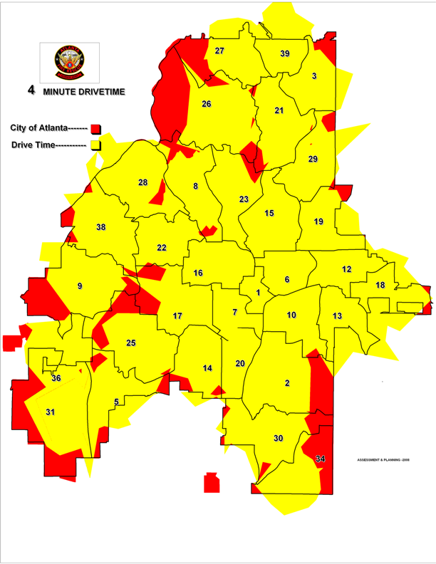

Slide 36
